Slide 1

Higgs boson triplet production at the LHC
Lovro Dulibić
advisor: Dinko Ferenček, PhD

Slide 2
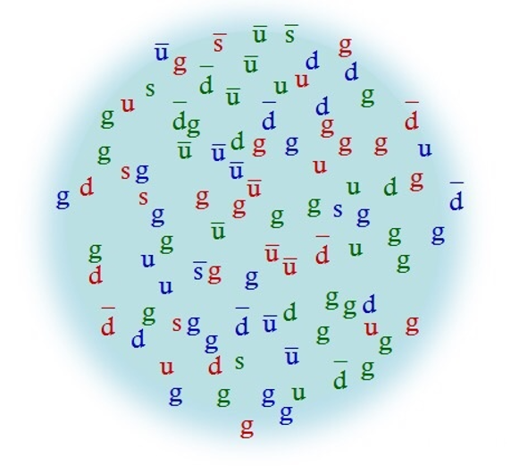
How is physics done at the LHC?
Experiment vs. theory
Problem?
Theory is of elementary particles; we are smashing
composite particles.
Those protons are even more complicated than
just uud because of the quark sea.
Solution - simulations

Slide 3
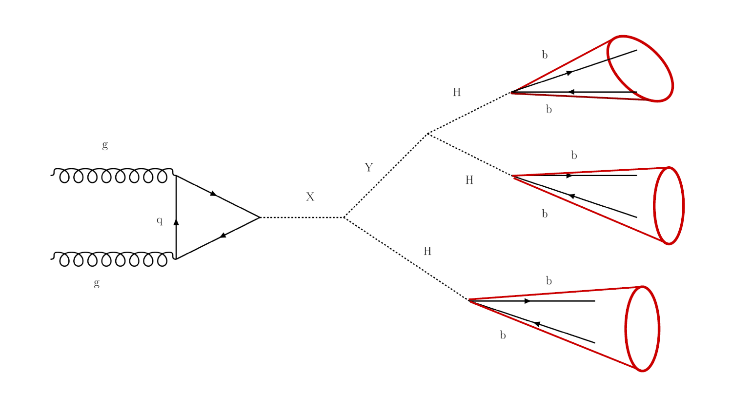

Higgs triplet – an extension of the scalar sector of the SM
$$m_{X}>m_{Y}>m_{H}$$

Slide 4
The analysis – an outline
Main variable of interest was the fraction of ‘boosted Higgs candidates’, i.e. how many jets have both b quarks.
We looked at the process for different masses of the proposed extra bosons.
We divided jets into ones ‘matched’ to particles which represent the signal, and ‘unmatched’ ones which represent the background.

Slide 5
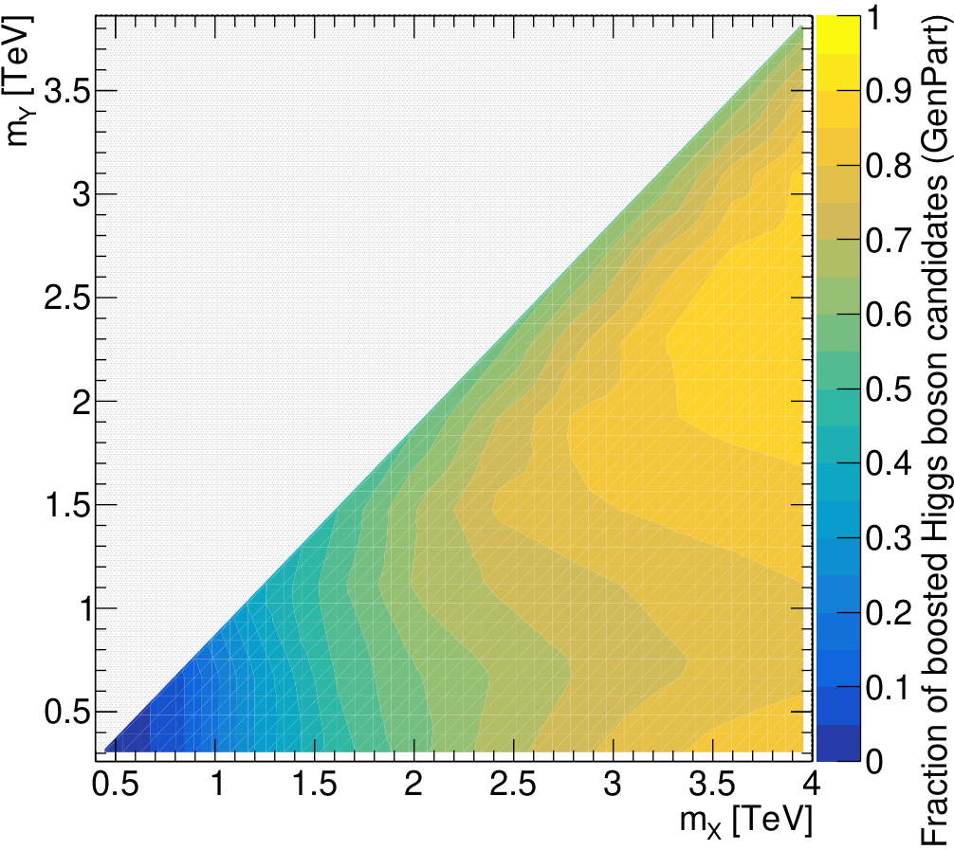
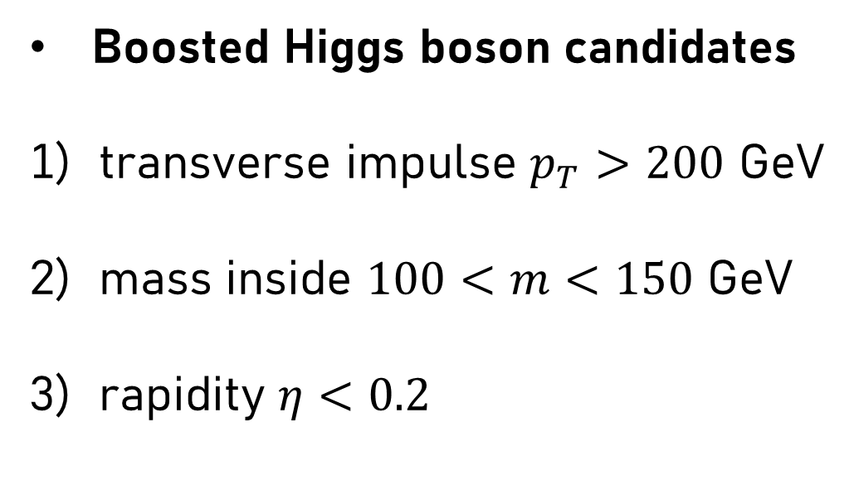
Generated particles
Boosted Higgs boson candidates
transverse impulse $p_{T}>200$ GeV
mass inside $100<m<150$ GeV
rapidity $η<0.2$

Slide 6
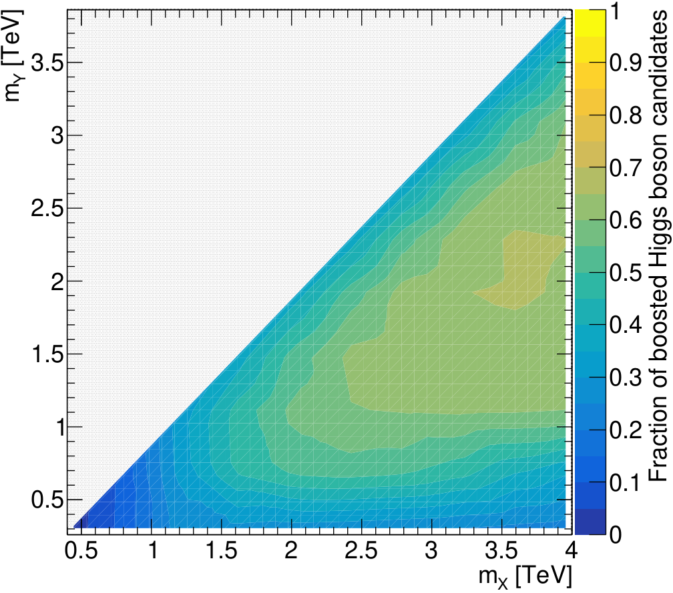
Generated particles
Jets after hadronization

Slide 7
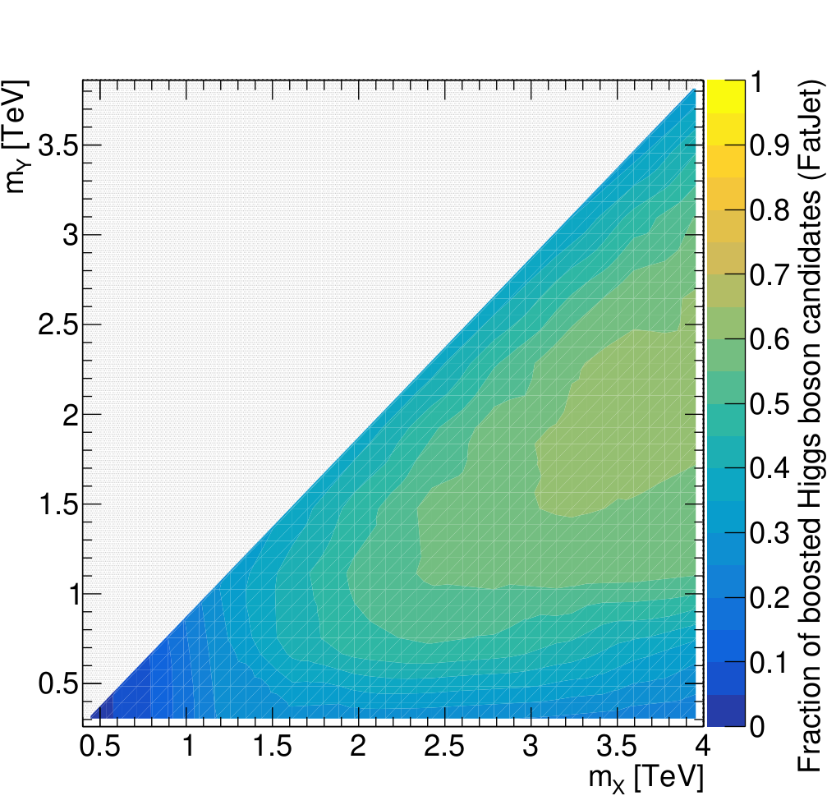
Generated particles
Jets after detector simulation

Slide 8
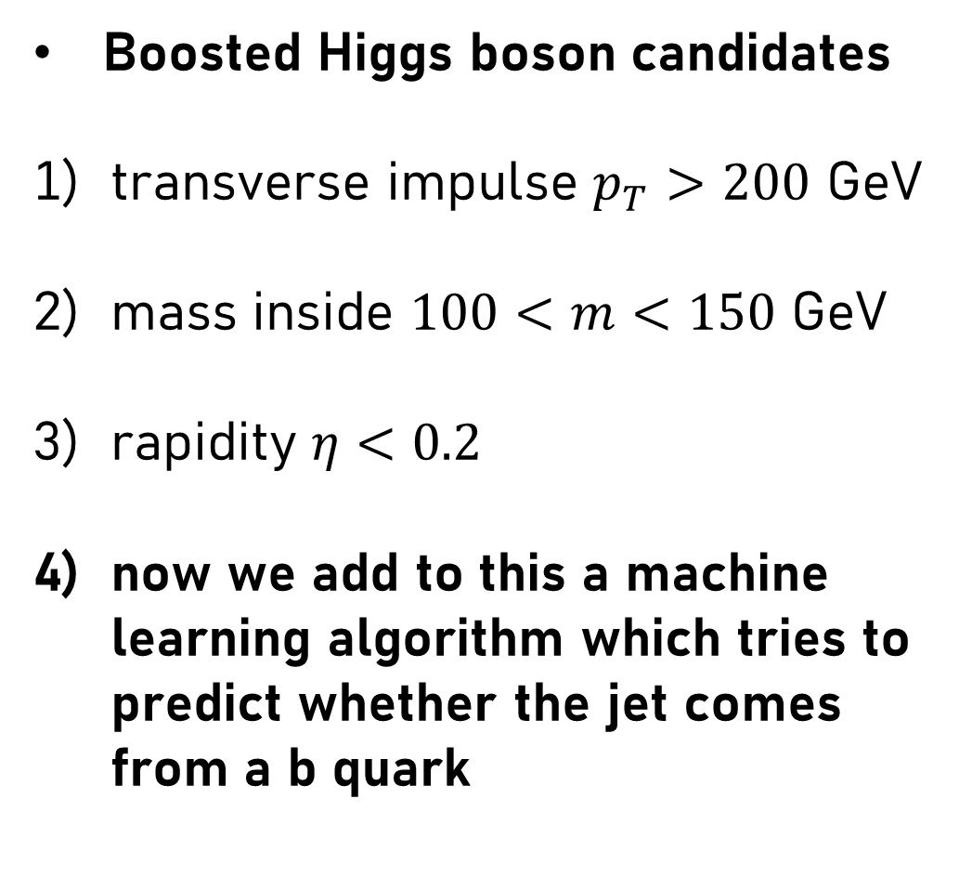
Jets after detector simulation
Boosted Higgs boson candidates
transverse impulse $p_{T}>200$ GeV
mass inside $100<m<150$ GeV
rapidity $η<0.2$
now we add to this a machine learning algorithm which tries to predict whether the jet comes from a b quark

Slide 9
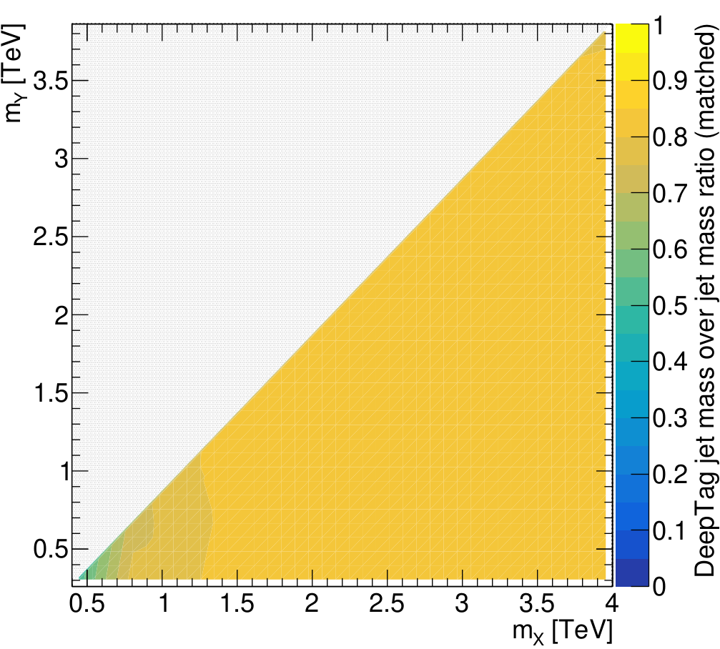
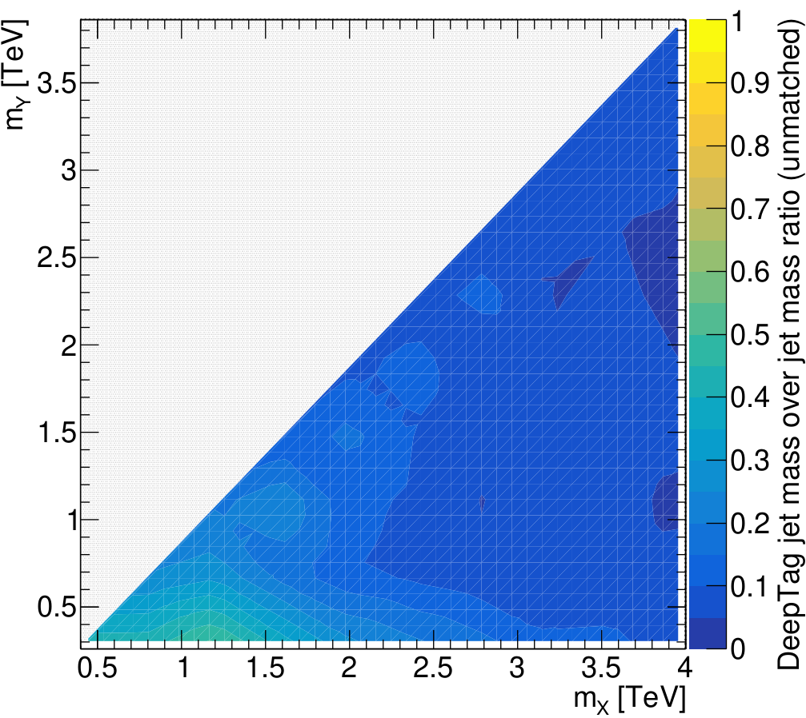
b-tagging algorithm - DeepTag
SIGNAL
BACKGROUND
Reduces the signal a bit, but gets rid of almost all the background.

Slide 10

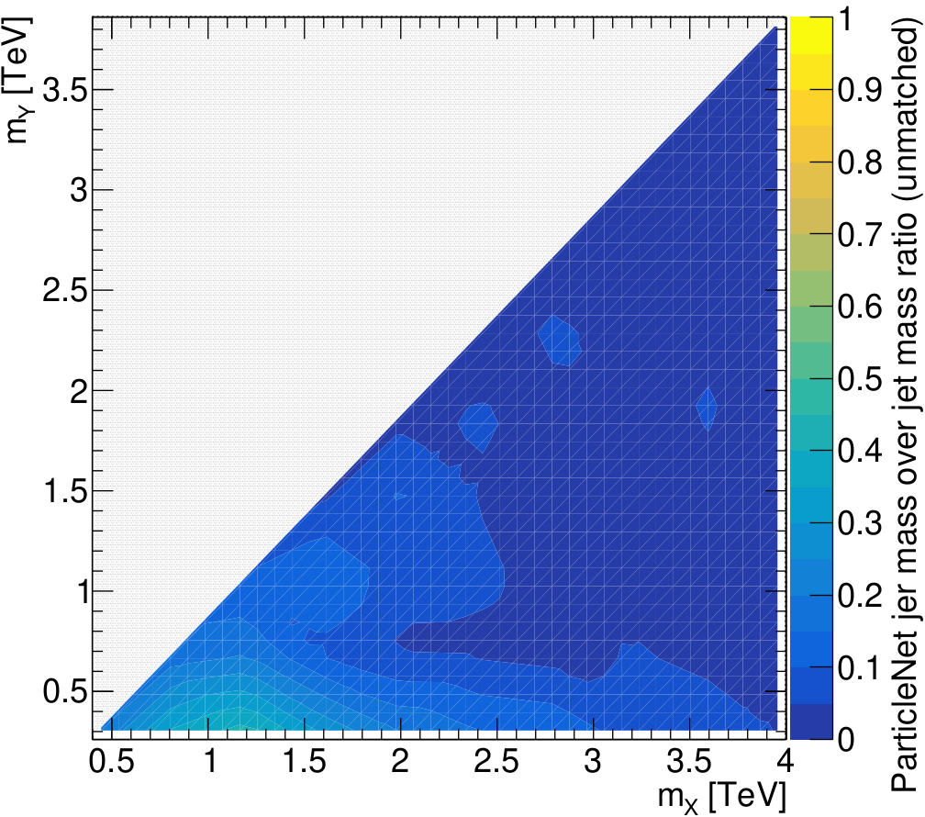
b-tagging algorithm - ParticleNet
SIGNAL
BACKGROUND
Gets rid of the background even better, but the signal also suffers.

Slide 11
Conclusion
We point out that this is merely one Feynman diagram, and without a real background. Meaning, there is still a lot of work to do if one were to try and compare theory to real data.
Tweaking and optimization of algorithms and conditions is crucial for a good analysis.

Slide 12
Thank you for your attention!
Lovro Dulibić
advisor: Dinko Ferenček, PhD

